Slide 1
inBloom, Inc. and data-sharing: The Threat to Student Privacy and Safety
Leonie Haimson, Class Size Matters
February 2014

Slide 2
What is inBloom Inc.?
inBloom Inc. non-profit corporation funded with $100M from Gates Foundation & Carnegie Corporation to collect, format and share personally identifiable student data with vendors.
Data uploaded onto a cloud operated by Amazon.com, with operating system built by Wireless Generation/Amplify, subsidiary of Rupert Murdoch’s NewsCorp..
NY RTTT districts told to sign up for “data dashboards” from 3 vendors, ConnectEDU, eScholar or NCS Pearson/Schoolnet, populated with data from inBloom cloud.
At least 40 districts returned RTTT funds but NYSED says their data will be uploaded anyway.
inBloom plans to commercialize this data, and w/ district consent, provide it to for-profit software vendors, to help them develop their “learning products.”

Slide 3
inBloom Timeline
May 5, 2011: NYSED sends letter to the State Comptroller, asking approval of a $27 million no-bid contract with Wireless Generation, to build state’s longitudinal student data system
June 8, 2011: Daily News reports on proposed contract. Controversy ensues, primarily because Wireless bought by Murdoch 6 months before, just days after Joel Klein announced resignation from DOE to work at News Corp.
July 2011: News Corp engulfed in a huge scandal, including phone hacking in UK. CSM, NYSUT and others urge State Comptroller to reject contract based on privacy concerns.
Aug 25, 2011: NY State Comptroller Thomas DiNapoli rejects contract: “in light of the significant ongoing investigations and continuing revelations with respect to News Corporation, we are returning the contract with Wireless Generation unapproved.”
December 13, 2011: the NY Board of Regents approves NYSED’s plan to share student data with Shared Learning Collaborative LLC, with an operating system built by Wireless for $44 million. Contract bypasses State & City Comptroller because no funds initially change hands.

Slide 4
Timeline (part II)
October 10, 2012: Class Size Matters, NYC parents and attorney Norman Siegel write SED, urging them to hold hearings and give parents the right to consent before children’s personal data is shared with inBloom.
October 24, 2012: SED says no need for hearings since plans are “public knowledge” – yet few if any elected officials, parents, superintendents or school board members know anything about this.
February 6, 2013: the Shared Learning Collaborative becomes inBloom Inc.
March 3, 2013: Stephanie Simon of Reuters writes the first national story about inBloom.

Slide 5
Parents erupt in rage throughout nation & 8 of 9 inBloom states pull out or put plans on hold
April 19, 2013: Louisiana Superintendent John White pulls data out of inBloom after protests.
May 4, 2013: Georgia Superintendent assures parents that he will not disclose any student data to inBloom.
May 29, 2013: Reuters confirms Delaware, Georgia and Kentucky have no plans to share data with inBloom.
August 1, 2013: The only NC “pilot” district, Guilford Co., pulls out of inBloom.
Nov. 7, 2013: After anti-inBloom slate of candidates sweeps election, Jeff Co. school board votes to withdraw & Colorado severs all ties to inBloom.
Nov. 26, 2013: Illinois says will keep data system separate from inBloom & allow districts to opt out; Chicago immediately pulls out.
Feb. 10, 2014: NYS Commissioner John King announces an indefinite delay on the launch of data dashboards related to inBloom.

Slide 6
What information is being shared?
Data NYSED will disclose to inBloom and dashboard vendors include student names, addresses, phone nos., emails, grades, test scores & proficiency levels, ethnicity, economic, racial and disability status, health (504) conditions, attendance and suspension records.
Info will include each student’s’ records from day s/he enrolls in school till graduation, including up to 12 yrs of data for HS students.
NYSED urging schools & districts to share even more detailed information, including detailed health & pregnancy information, family structure and immigration records.
After graduation, all data to be transferred to State Archives for minimum of 8 years, with unclear restriction on access.

Slide 7
What is inBloom’s goal?
InBloom claims that this project will lead to greater efficiency, data analysis and integration, and create a vibrant market in “personalized” learning tools – by allowing vendors to data-mine student information & create “interoperable” software programs.
Ken Wagner of NYSED says that service providers, tools and standards will converge in "a magic mix that hasn't come together before."
In NYC, the Department of Education spent $80M on ARIS data system, with data dashboards also built by Wireless Generation. Many of same claims were made, yet ARIS is rarely used and considered by many a boondoggle.

Slide 8
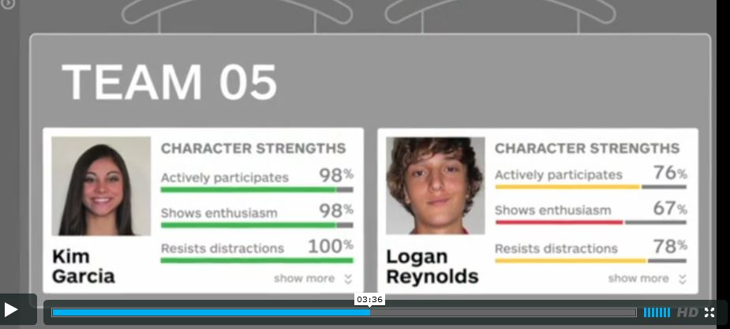
Dashboards will also include “warning flags” and “behavioral incidents” Sample dashboard from inBloom video

Slide 9
What about security?
In survey, 86% of technology experts say they do not trust clouds to hold their organization’s “more sensitive” data.*
inBloom’s security policy: they “cannot guarantee the security of the information stored in inBloom or that the information will not be intercepted when it is being transmitted.”
In April, the personal information of 50 million LivingSocial customers was disclosed when an Amazon.com cloud was hacked.
Last month, Target breach affected up to 110 million customers.
*Lieberman Software's 2012 Cloud Security Survey

Slide 10
What about privacy?
Though NYSED claims inBloom FERPA-compliant, Family Educational Rights and Privacy Act regulating privacy of educational records.
FERPA regs weakened by US Dept of Ed in 2009 and 2011 to encourage data sharing with contractors & “authorized agents” without parental consent.
US Dept of Ed was sued in federal court for rewriting FERPA in way violates original intent and language of law.
The same data stored in child’s health records or gained through online usage could NOT be shared with any 3rd parties without parental consent, acc. to HIPAA (Health Insurance Portability and Accountability Act) or COPPA (Children’s Online Protection Act)

Slide 11
Issues with the dashboards -- even if there are no breaches
Minor incidents will now enter into a student’s permanent record and be easily accessible to teachers and others through the dashboards.
Research shows that teachers tend to stereotype students based on prior knowledge and that this can become a self-fulfilling prophecy.
If dashboards reveal details in an academic or disciplinary history before teachers have met students, this can create negative expectations that seriously impair their prospects.

Slide 12
Considerable costs & risks to states/districts
Starting in 2015, inBloom says will start charging state $2-$5 per student per year. State says only has RTTT funding for this thru Sept. 30, 2014; unless it can get renewal.
Data dashboard vendors to charge districts an additional $1-$3 per year; plus additional fees for any other software tools using data drawn from the inBloom cloud.
If this data leaks out or used inappropriately, potential cost to the state or district from class action lawsuits far greater, since inBloom & Gates Foundation have insulated themselves from liability.
inBloom has said it is also “exploring” charging vendors for its services. If not selling student data, this could be likened to renting it out.

Slide 13
Huge resistance from district officials & electeds of both parties
Survey: 75% of NYS school board members oppose inBloom plan; 78% say parents should be allowed to opt out
At least 40 superintendents return RTTT funds to opt out of data dashboards (though NYSED says will share their student info anyway)
Sen. Flanagan, head of Sen. Ed Committee, calls for 1 year moratorium on sharing data w/inBloom.
50 Assemblymembers send letter to Commissioner expressing serious concern
Speaker Silver calls for immediate halt to any further data sharing until “confident that this information can remain protected.”

Slide 14
Data collection/connection with Common core
InBloom sold itself as helping states and districts attain higher standards with CC aligned materials and software tools.
With uniform tests and test score data across nation, multi-state databases more valuable to vendors & groups like Gates Foundation.
Through federal stimulus funds & RTTT, US Dept of Ed pushed states to create longitudinal “cradle to grave” data systems
These systems supposed to collect info on children among many state agencies and provide it to researchers and others.

Slide 15
What about legislation?
Last session, two bills were passed with bipartisan support by NYS Assembly to block inBloom.
A.6059A sponsored by O’Donnell would bar re-disclosures of personal student data without parental consent, and would require full indemnification for data breaches.
A.7872A sponsored by Nolan would allow parents the right to opt out of their child’s personal data being shared with any third parties.
Identical versions have been introduced in the NYS Senate, by Senator Robach, S.5932 and Senator Martin, S.5930.
Sen. Flanagan has introduced new privacy bill, S. 6007, allowing for district opt out but no parent opt out.

Slide 16
How can you help?
Contact your legislators; ask them to support O’Donnell/ Robach bill, A.6059A/ S.5932;
Sign anti-inBloom petition http://petitions.moveon.org/sign/protect-new-york-state
Sign up for updates at www.classsizematters.org

Slide 17
Even if we defeat inBloom…
Parents need to know exactly what districts are already doing w/our children’s private data.
Every parent should ask their principal &/or Superintendent what personal data is being disclosed to which 3rd parties & under what conditions.
With growth of online learning & Common Core standards, student data is now incredibly valuable
K12 education $500 billion potential market that vendors eager to get their hands on.

